Slide 1
Test Beam 2025
Gap Analysis
Ben Talmor

Slide 2
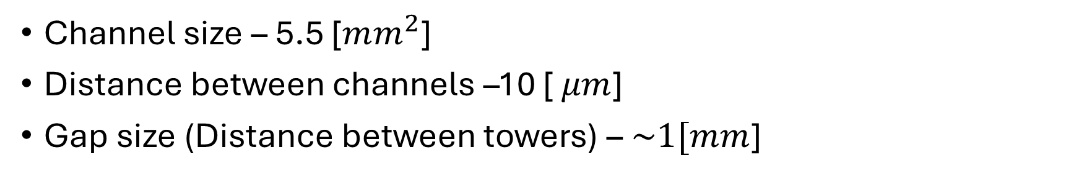
Motivation
Find the uncertainties around the Gap
Overcome them using numerical / physical solutions
Properties
Channel size – 5.5 [$mm^{2}$]
Distance between channels –10 [ $μm$]
Gap size (Distance between towers) –$\sim 1[mm$]

Slide 3
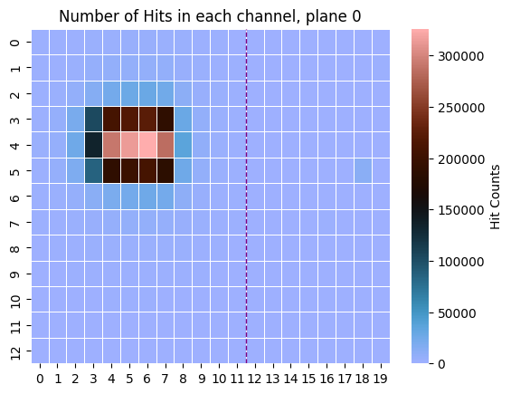
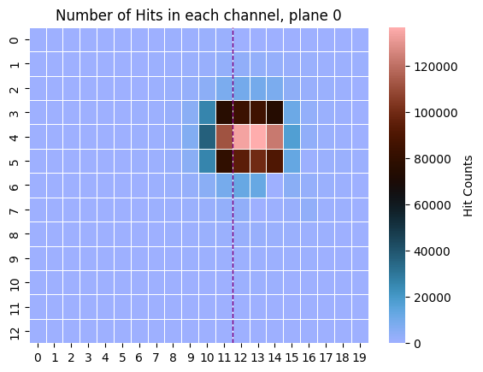
Run Location on the Sensor Initial shower
Run 1101
Run 1063

Slide 4
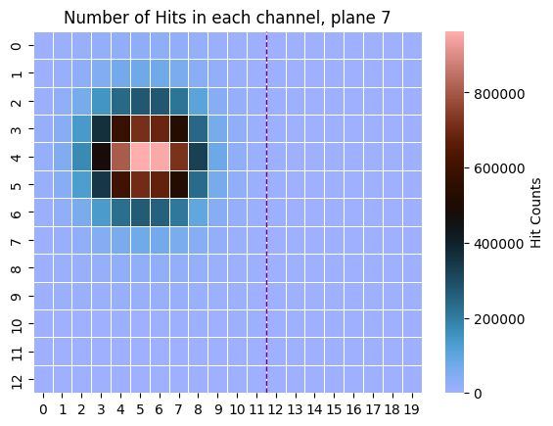
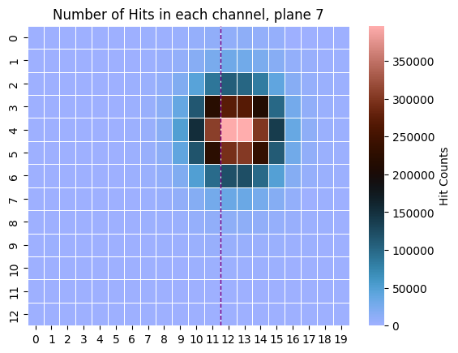
Run Location on the Sensor End of Shower
Run 1101
Run 1063

Slide 5
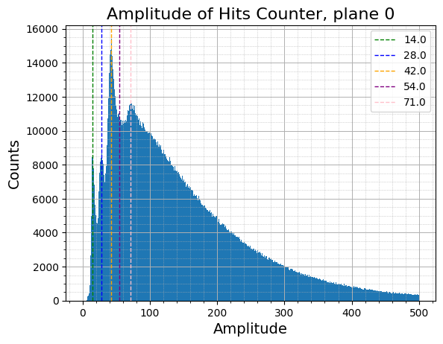
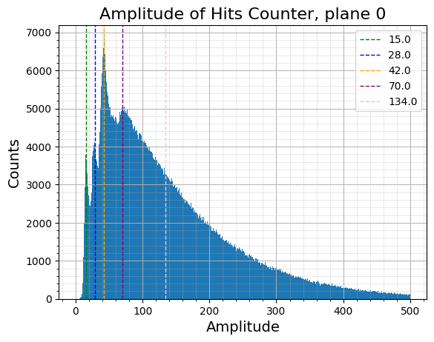
Energy Histogram in The First Plane
Run 1101
Run 1063

Slide 6
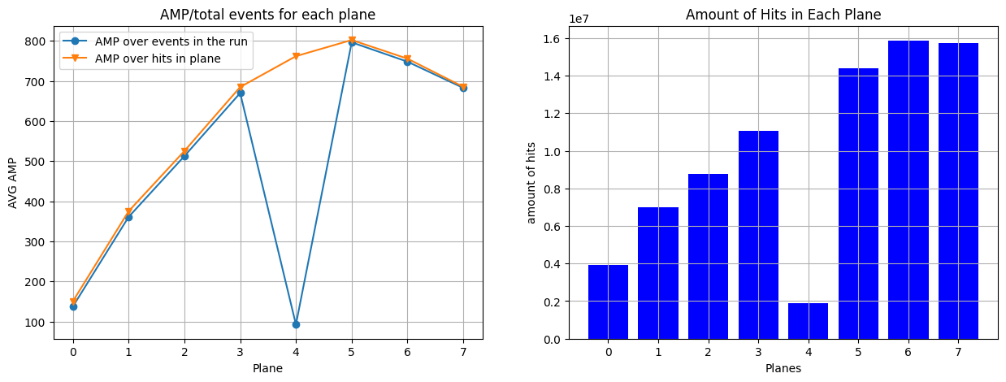
Energy distribution Run 1101

Slide 7
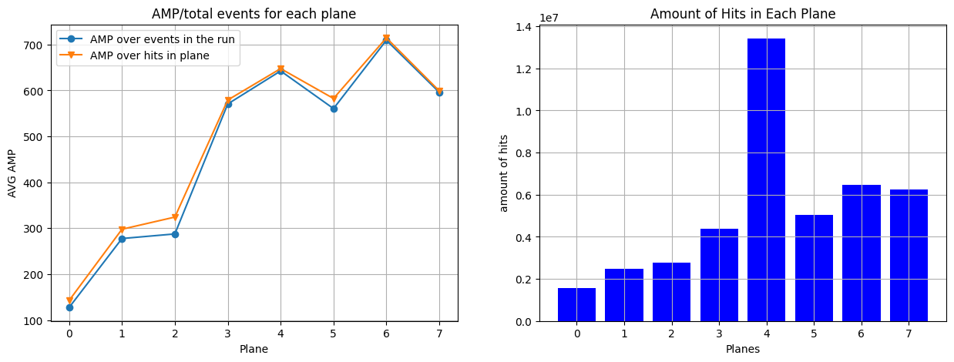
Energy distribution Run 1063

Slide 8
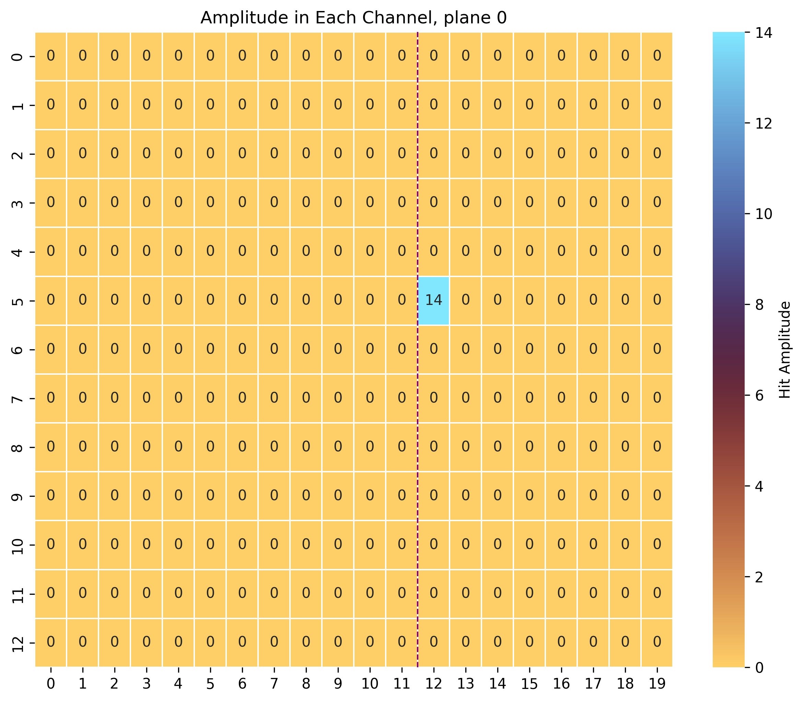
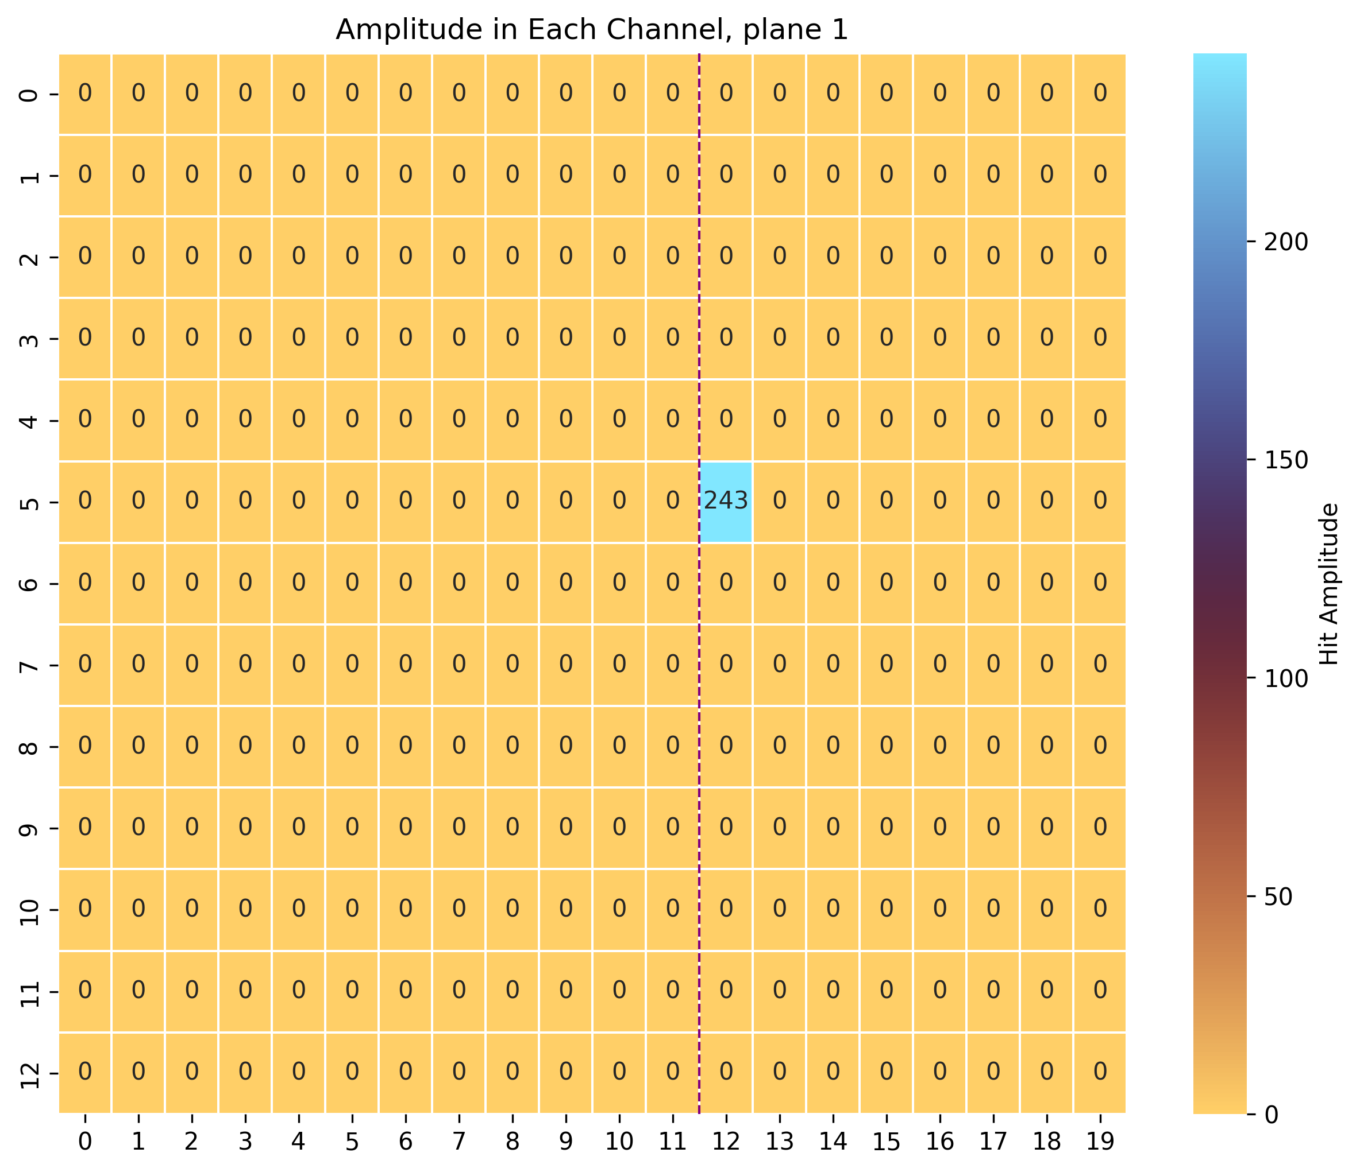
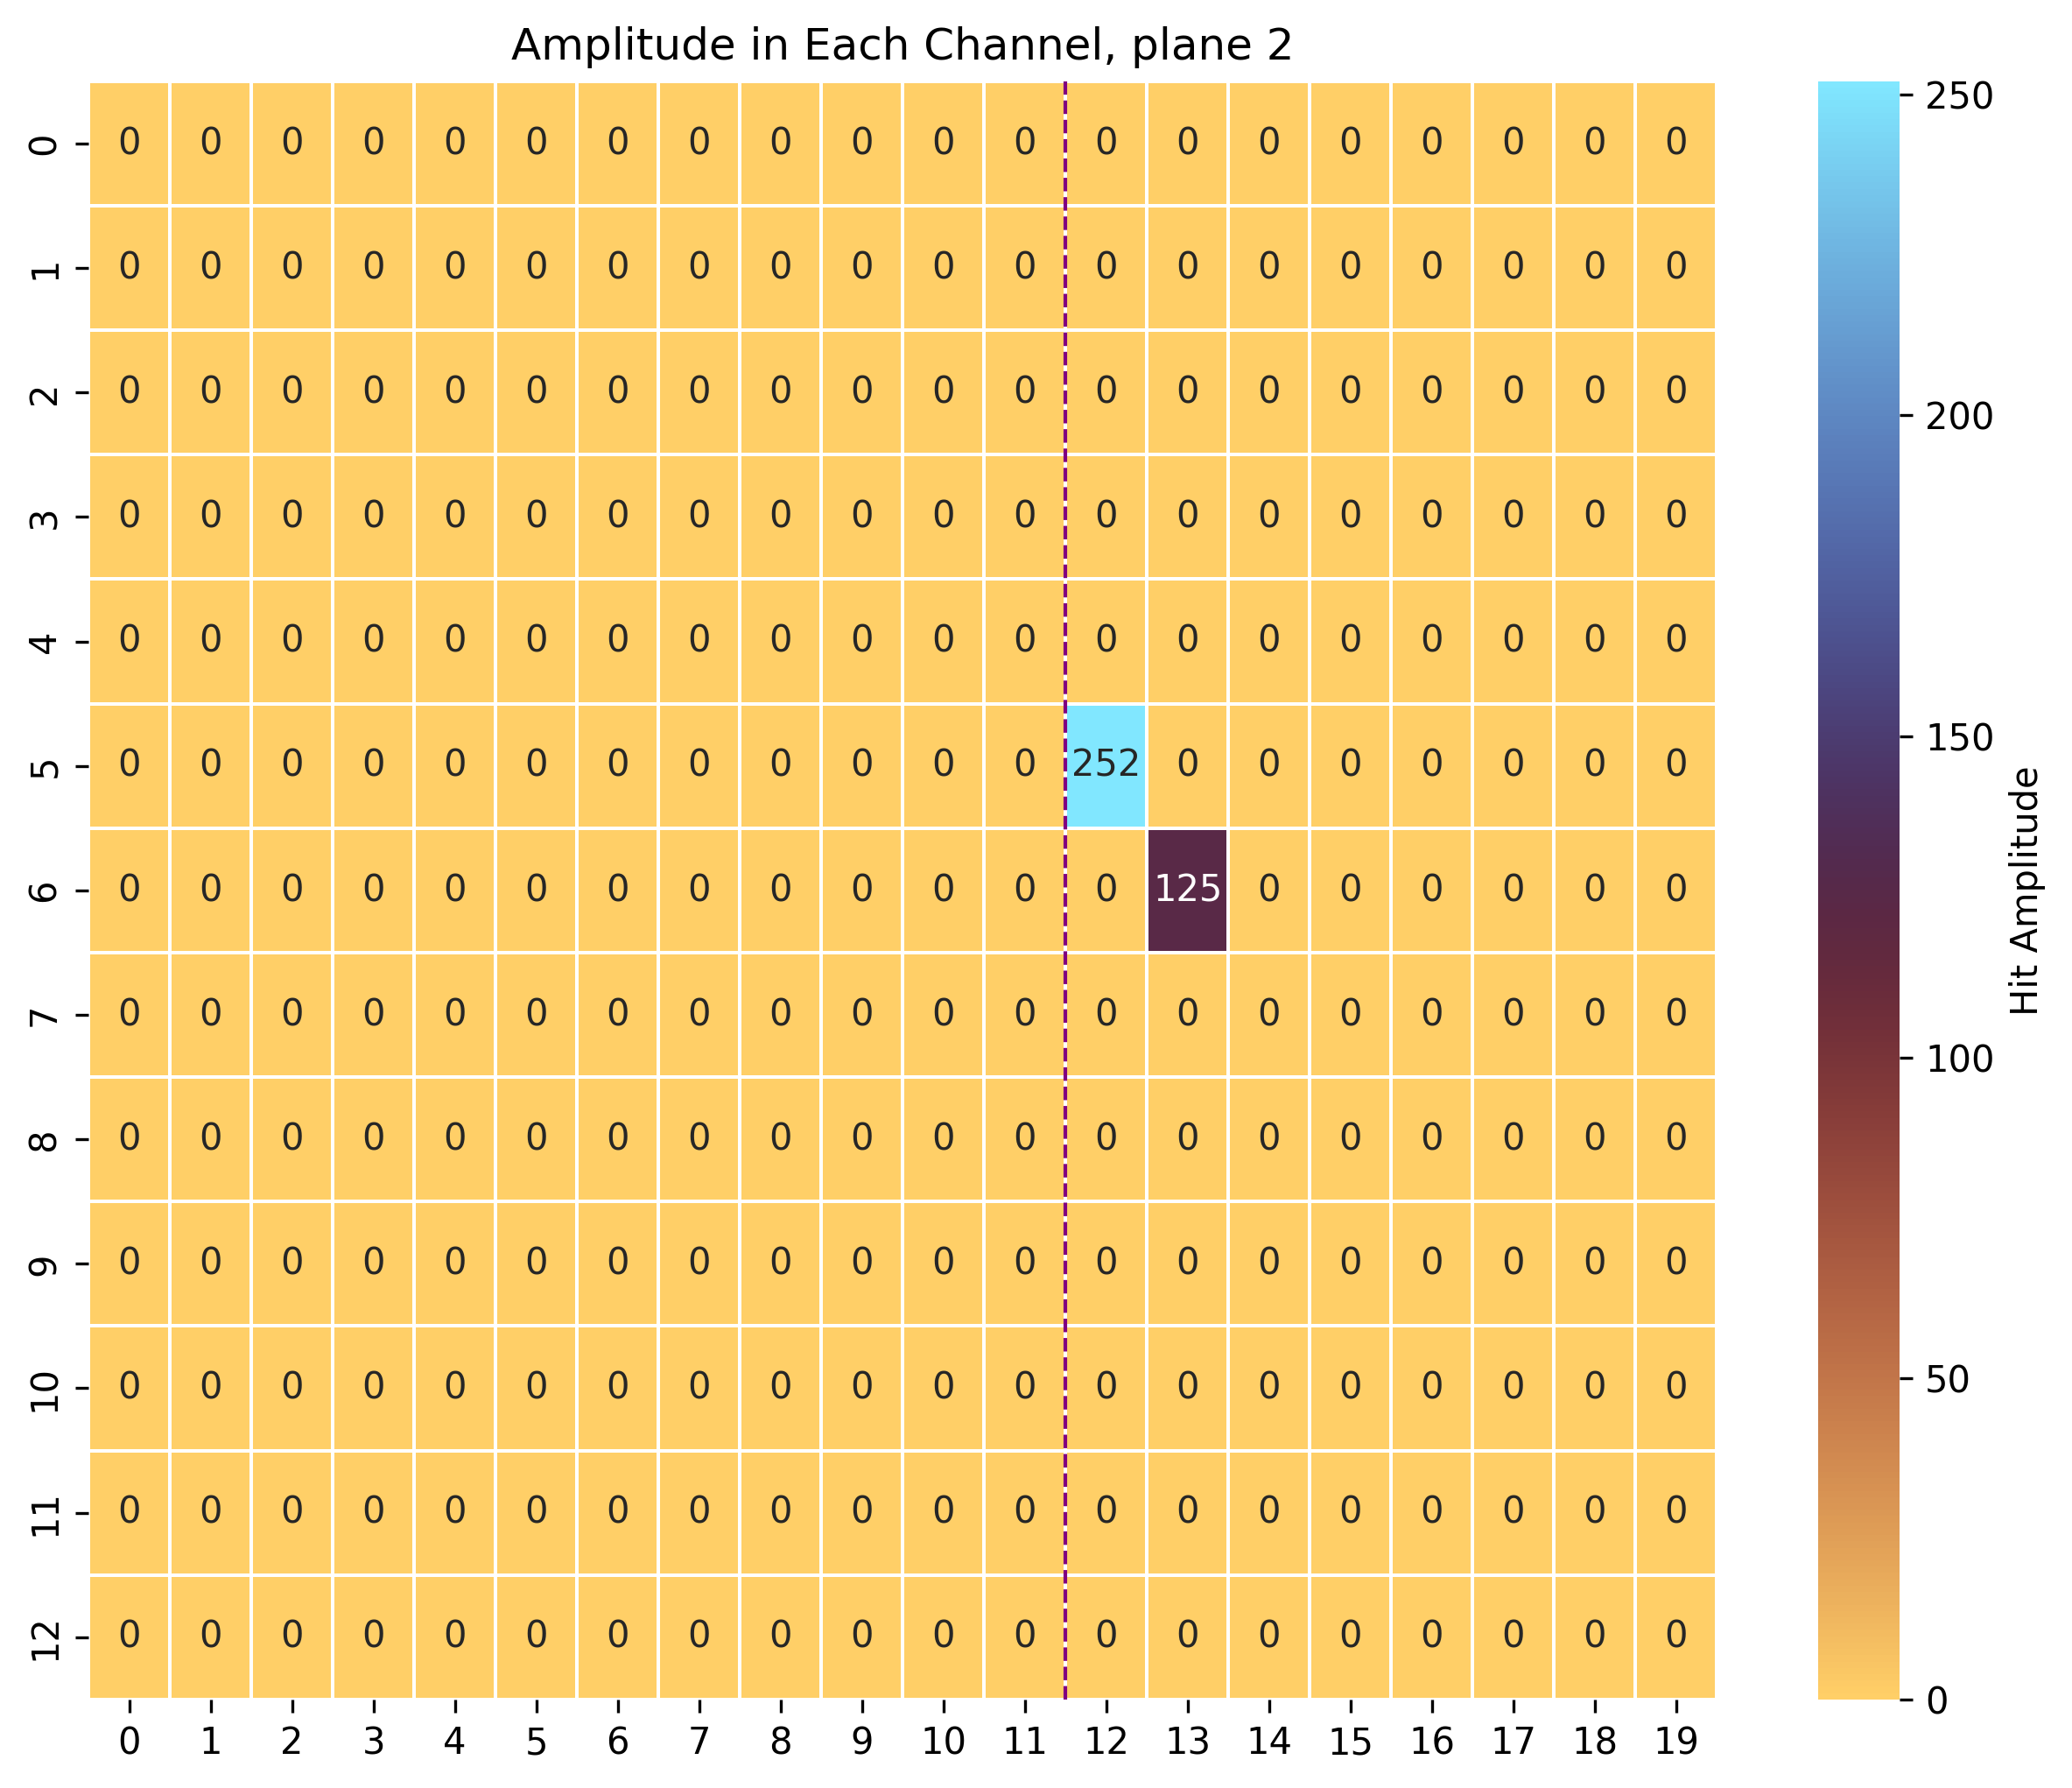
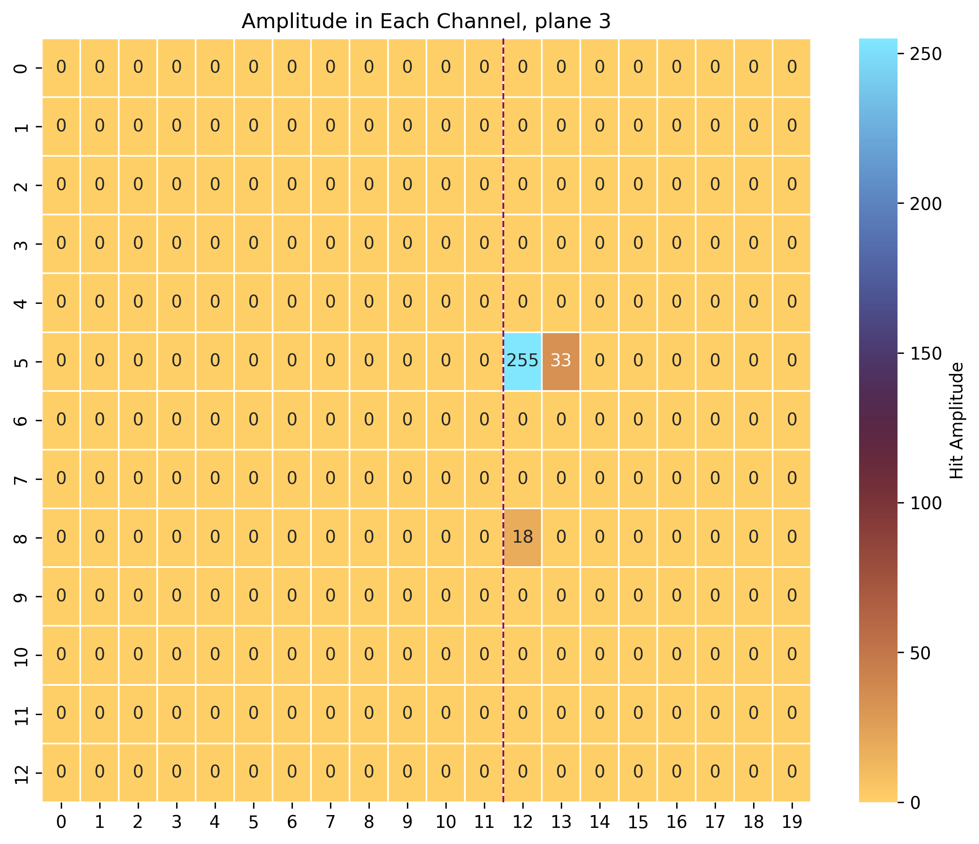
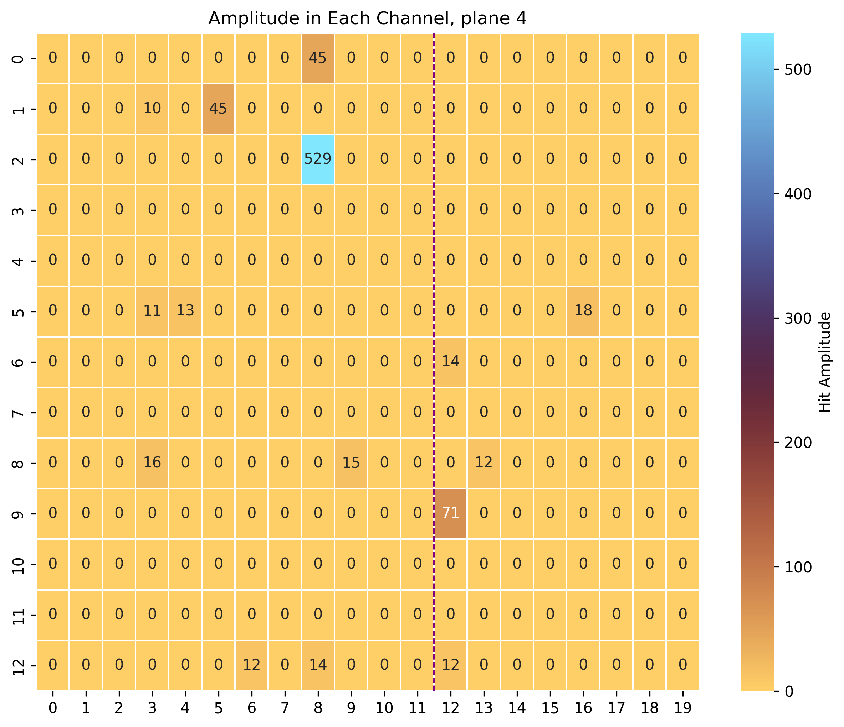
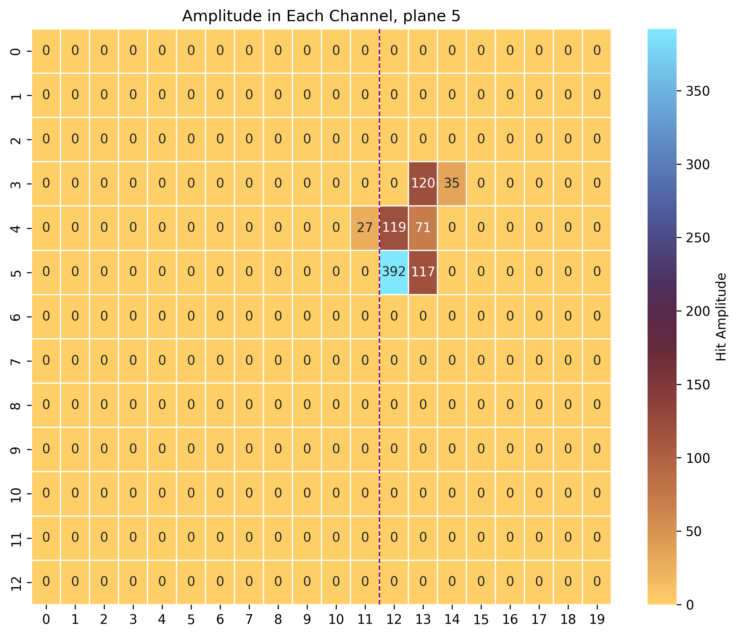
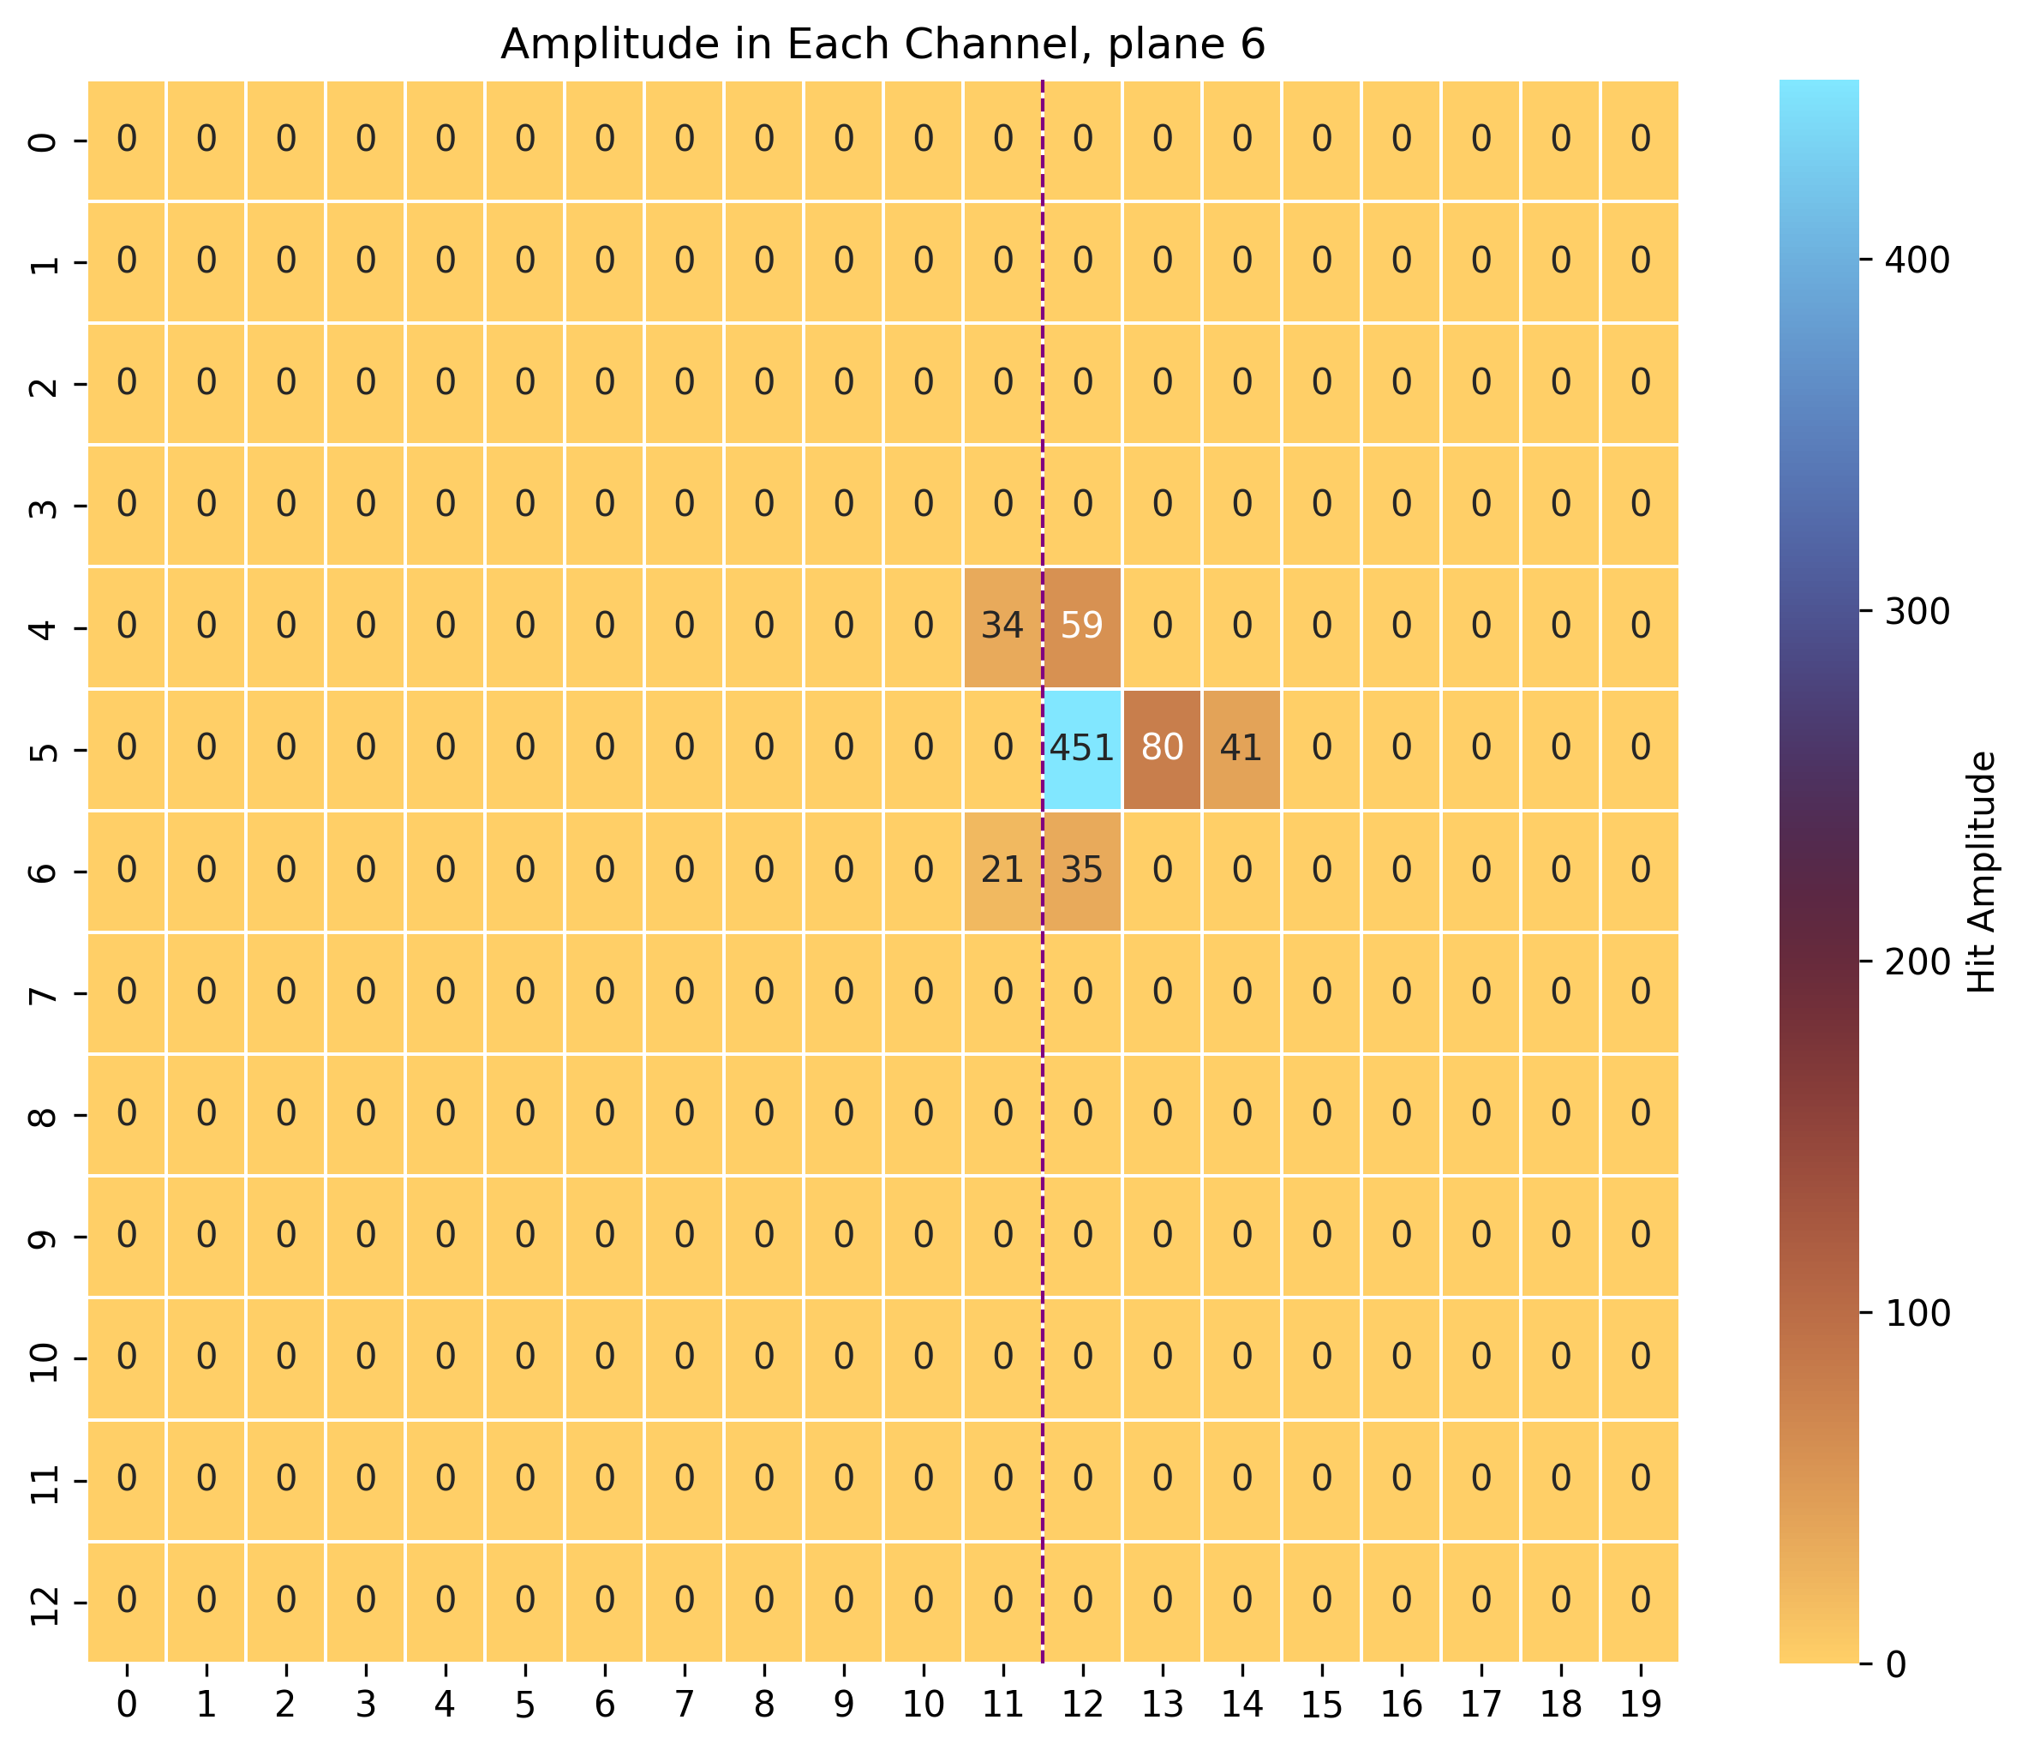
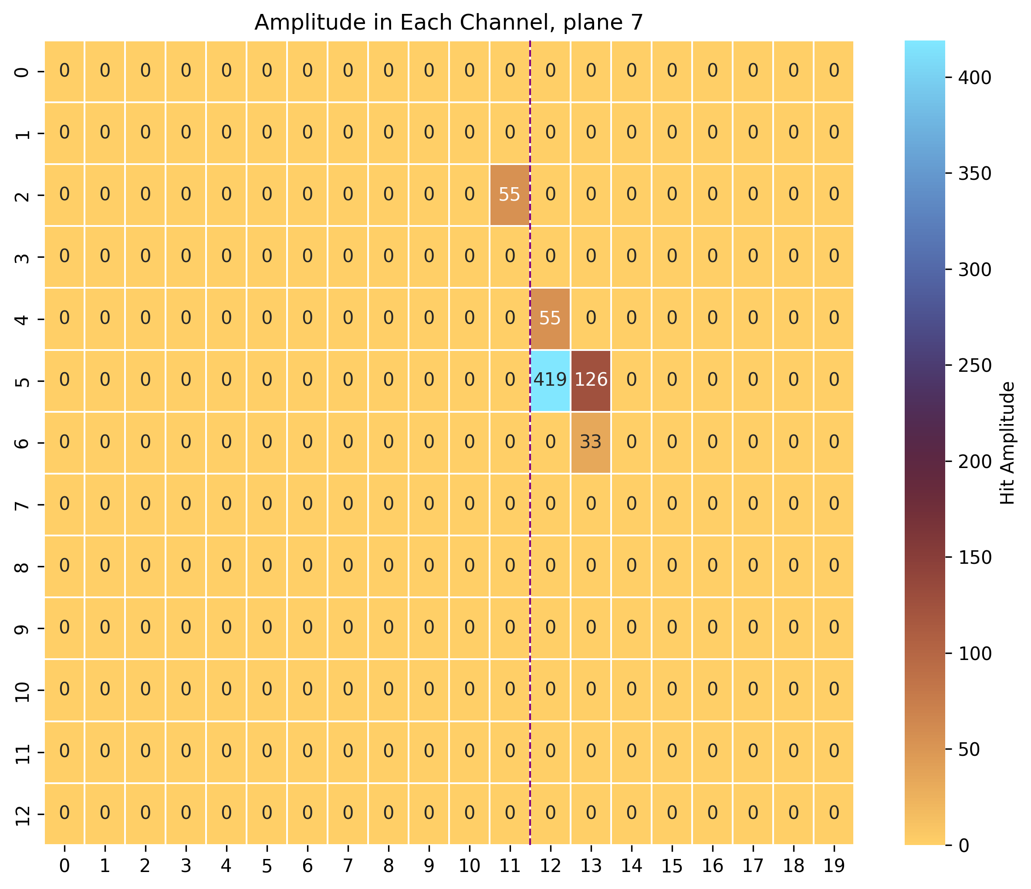
Event Evolution Run 1063 TLU 132119

Slide 9
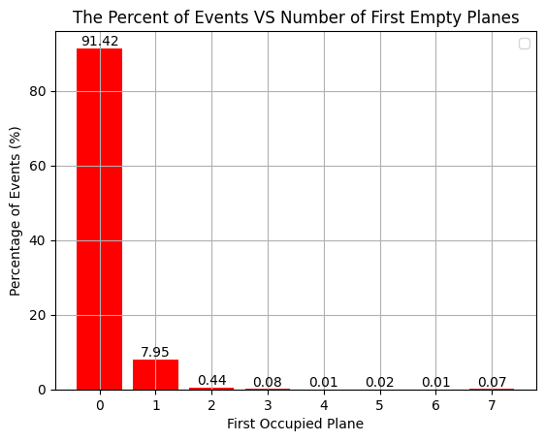
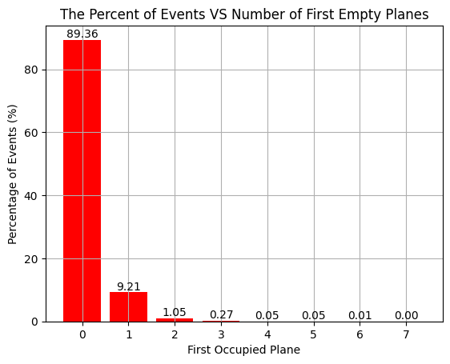
Initial Plane of the Shower
Run 1101
Run 1063

Slide 10
Overlook
Energy analyses for different Distances
Energy per plane
Total Shower Energy
Shower size

